Slide 1


Loan prediction model
Project Group Members ~ Irina Fedorova, Rachel Newberry, Madhusudan tamrakar

Slide 2

Loan prediction model
agenda
Agenda
Situation Analysis
Data Source
Objective of Machine Learning Model
Classification Model Selection
Data Cleaning Process
Exploratory Data Analysis: Visualization
Encoding and Separating for Training
Model Results

Slide 3


Loan prediction model
Loan process overview & insights
Tedious Process
Recipient
Lender

Slide 4
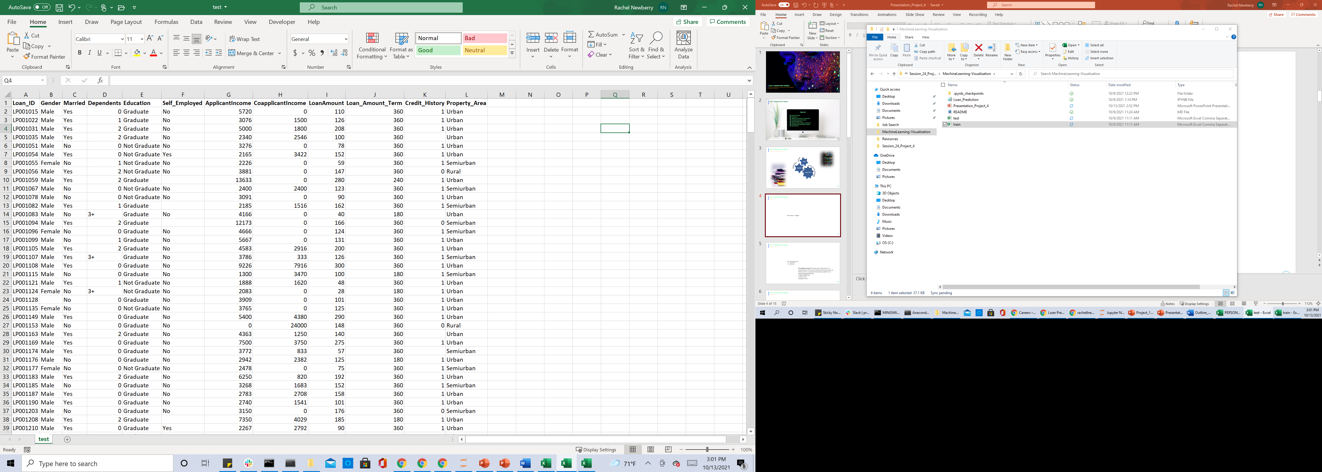

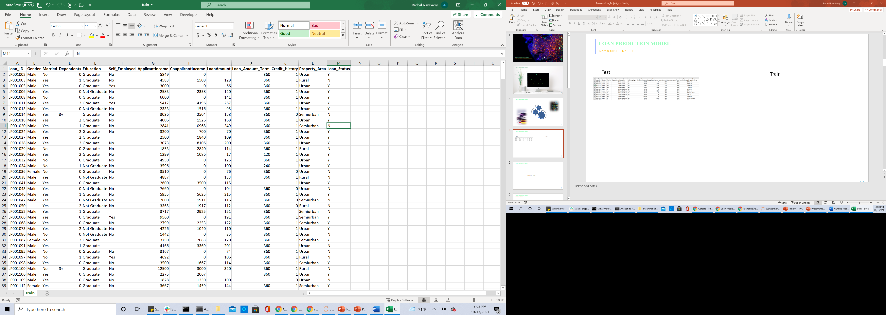

Loan prediction model
Data source ~ Kaggle
Test
Train

Slide 5




Loan prediction model
Supervised classification
Supervised Classification Model
Logistic Regression
Decision Tree
Random Forest
The problem at hand: The aim of this project is to predict which of the customers will have their loan paid or not.

Slide 6
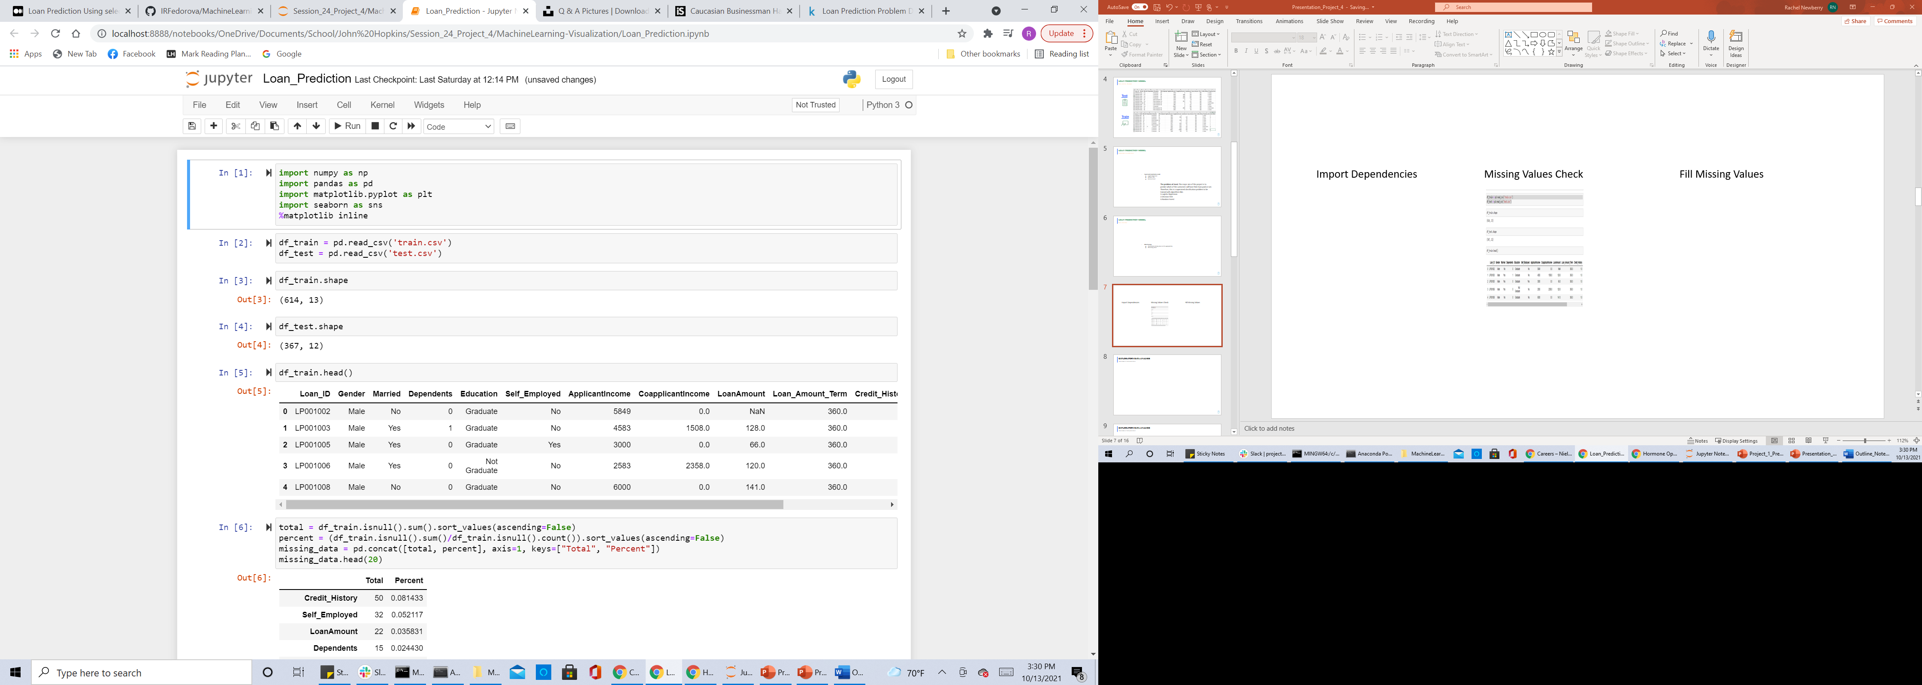
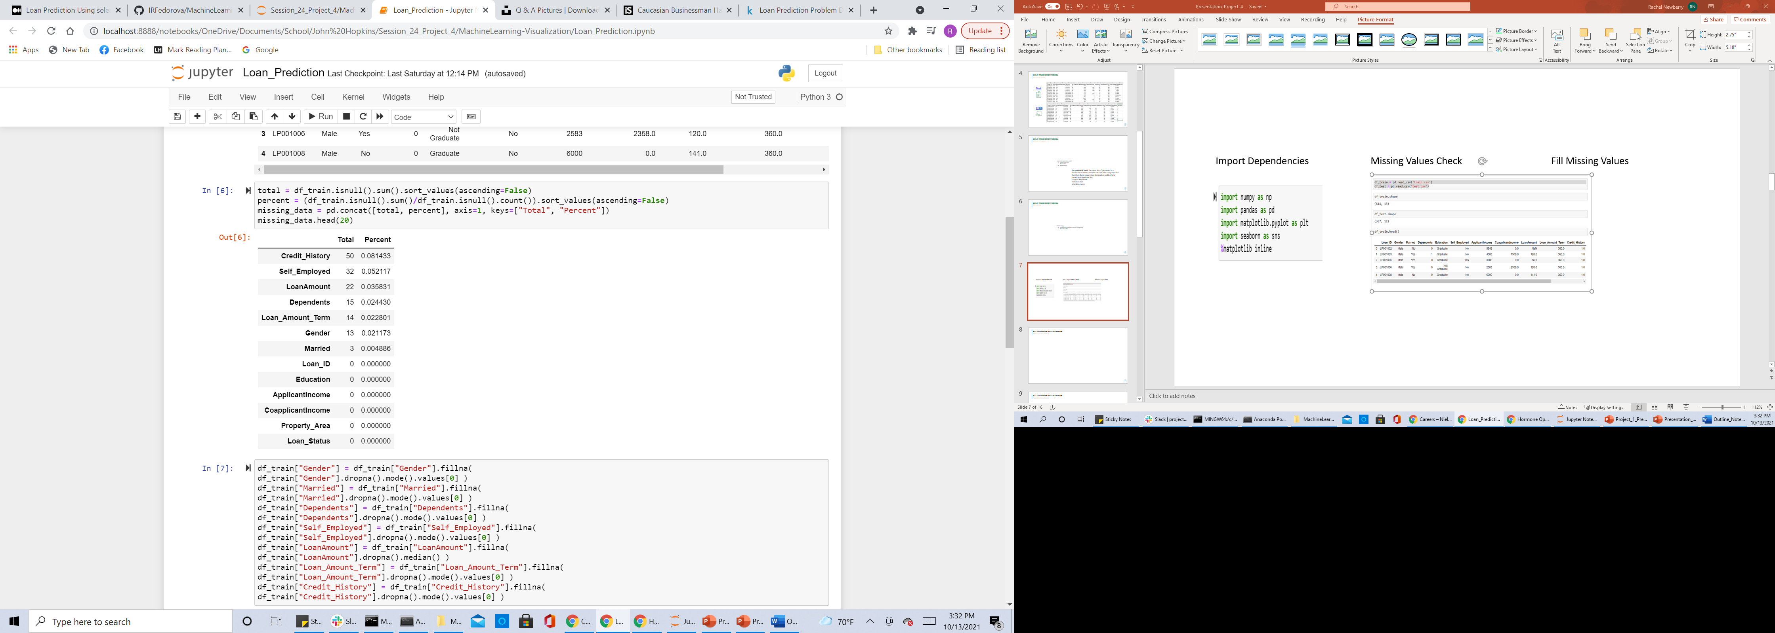
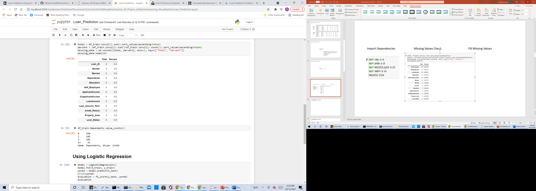

Loan prediction model
Data cleaning
Import Dependencies
Missing Values Check
Fill Missing Values

Slide 7

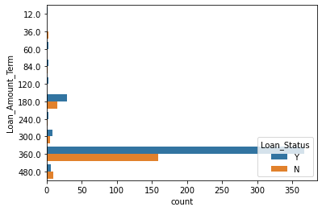
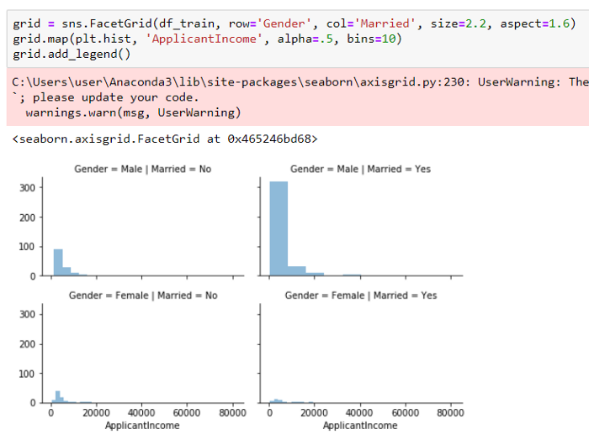
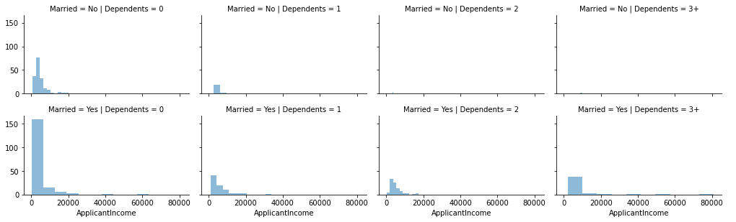
Exploratory data analysis
The power of visualizations
Hard to Read

Slide 8
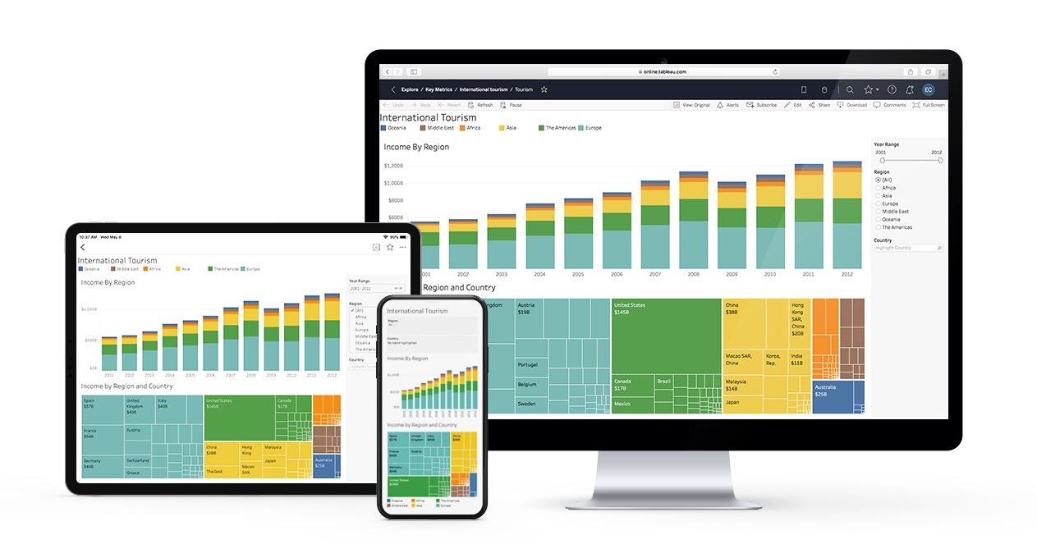

Exploratory data analysis
The power of visualizations
Tableau…
A Client Friendly Experience

Slide 9
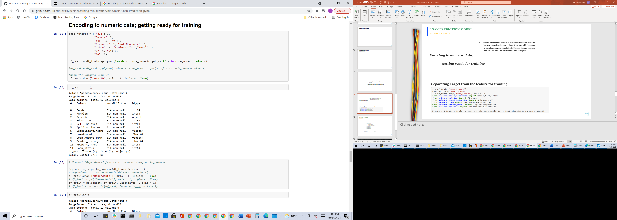
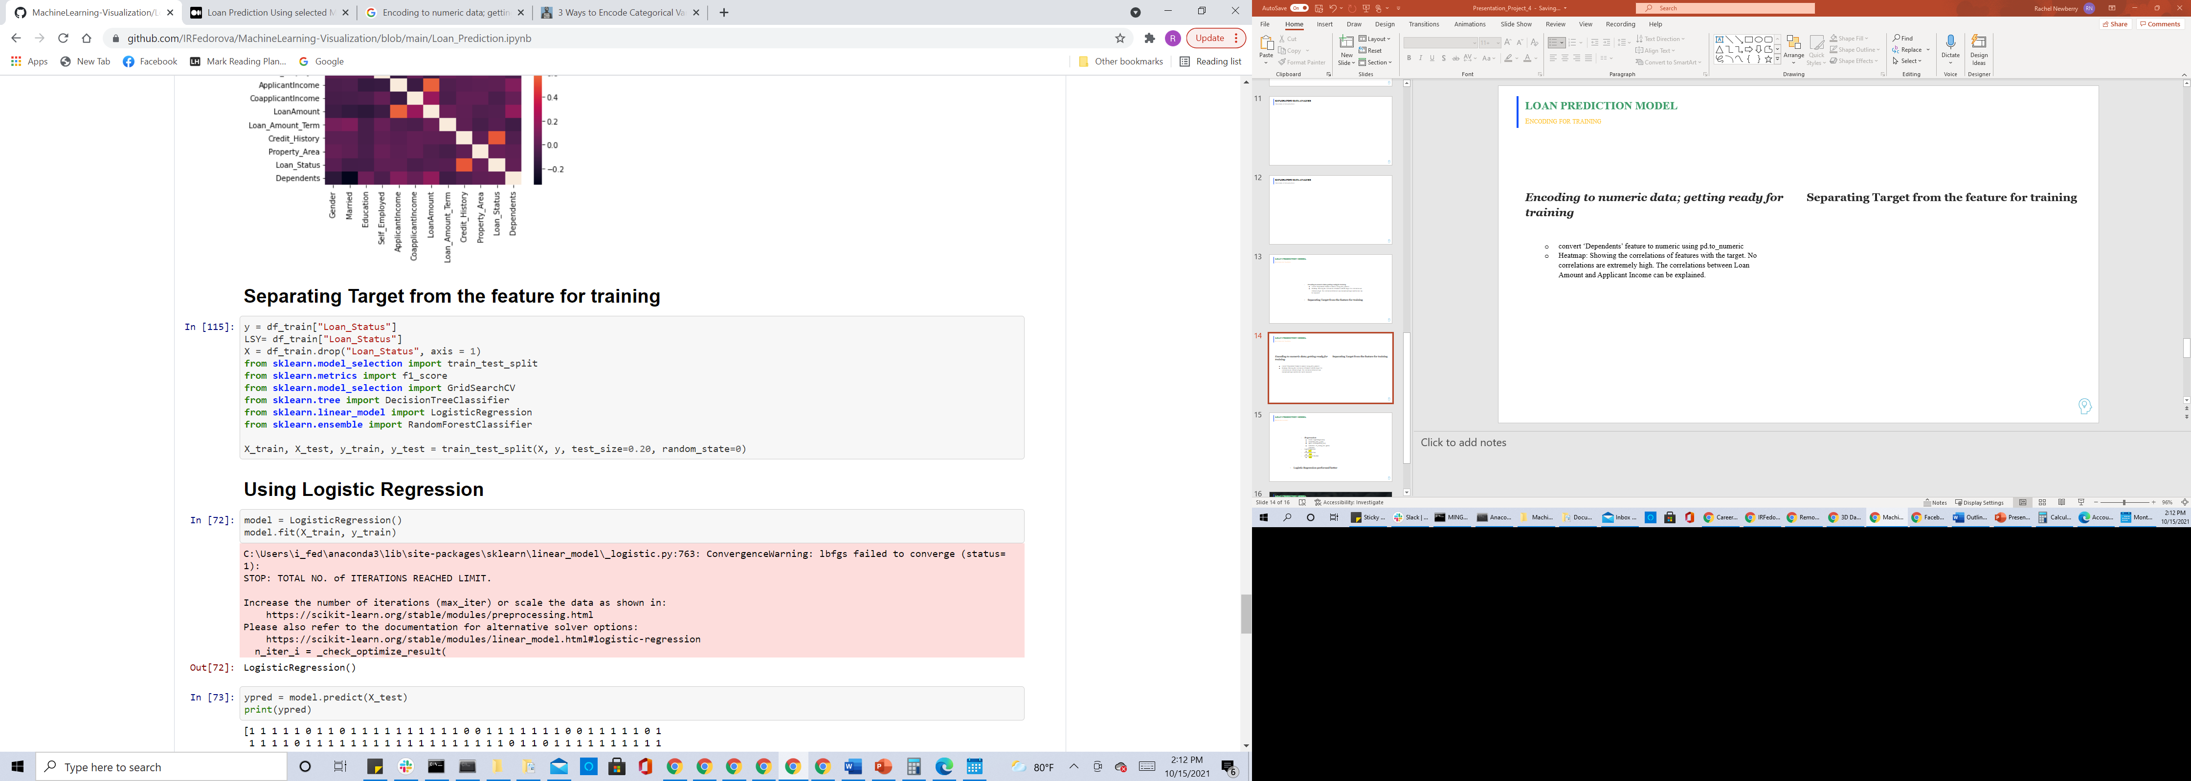
Loan prediction model
Encoding for training
Encoding to numeric data; getting ready for training
Convert “Dependents” feature to numeric using pd.to_numeric
Separating Target from the feature for training

Slide 10

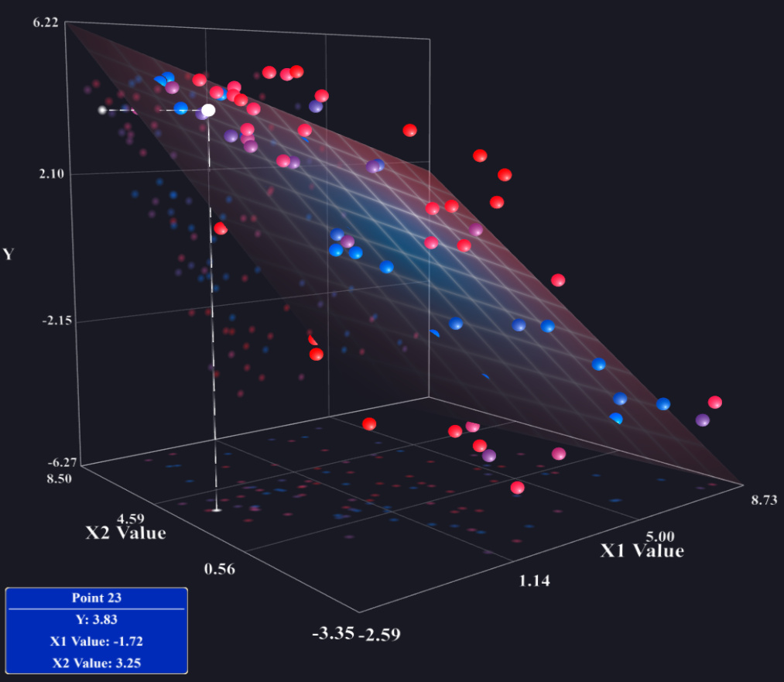
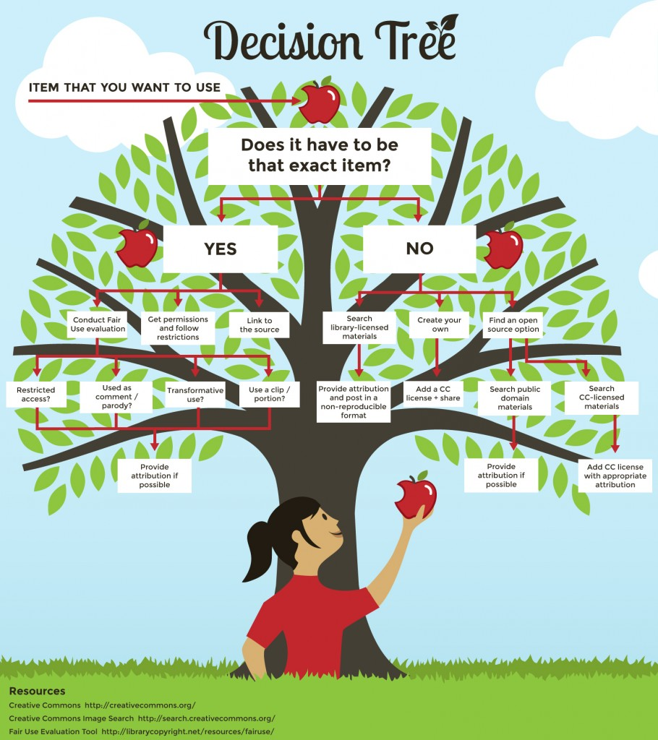

Loan prediction model
Regression models
Which model is ideal to predicate which of the customers will have their loan paid or not?
Logistic Regression
Decision Tree
Random Forest Classifier
89%
77%
85%

Slide 11

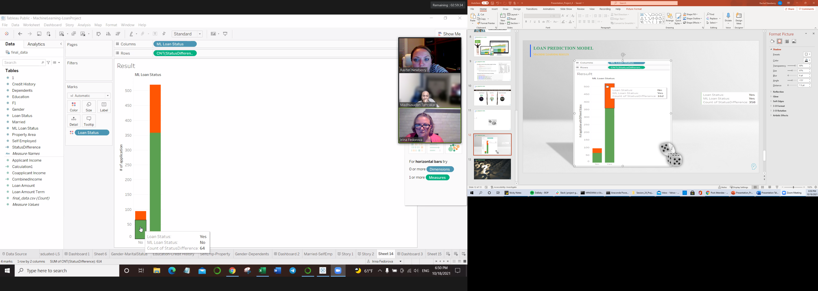
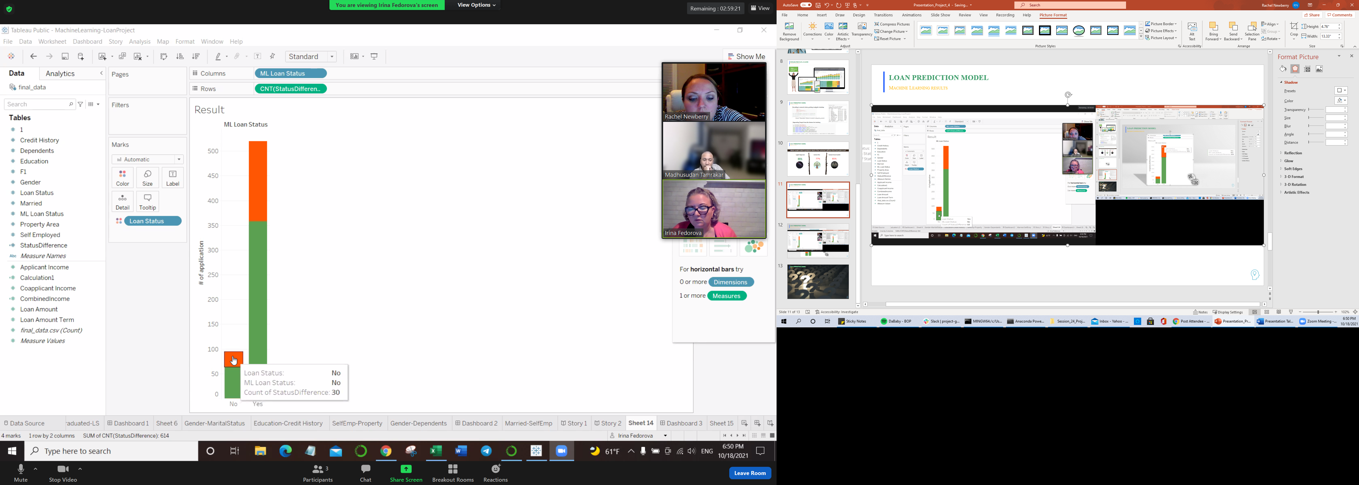

Loan prediction model
Machine Learning results
162
358

Slide 12

Loan prediction model
discussion

